Slide 1
A Financial System Architecture That Offers Virtual Card
System ACHITECTURE ASSIGNMENT
By
MAMBO ANNABEL AND FRU PATIENCE

Slide 2
What the System Offers
A modern, secure, and scalable financial platform enabling virtual card issuance, wallet management, and digital payments.

Slide 3
Technology Stack Overview
• Frontend: Flutter (Dart) • Backend: Go (core), Python (fraud detection) • Gateway: NGINX • Databases: PostgreSQL, Redis • Messaging: Apache Kafka • Infra: Docker, Kubernetes, Terraform

Slide 4
Core Microservices
• Authentication & Authorization (OAuth2, JWT, MFA) • User Management • KYC Verification (3rd-party) • Fraud Detection (AI/ML Rule Engine) • Payment Processing • Wallet & Cashing • Notification Service

Slide 5
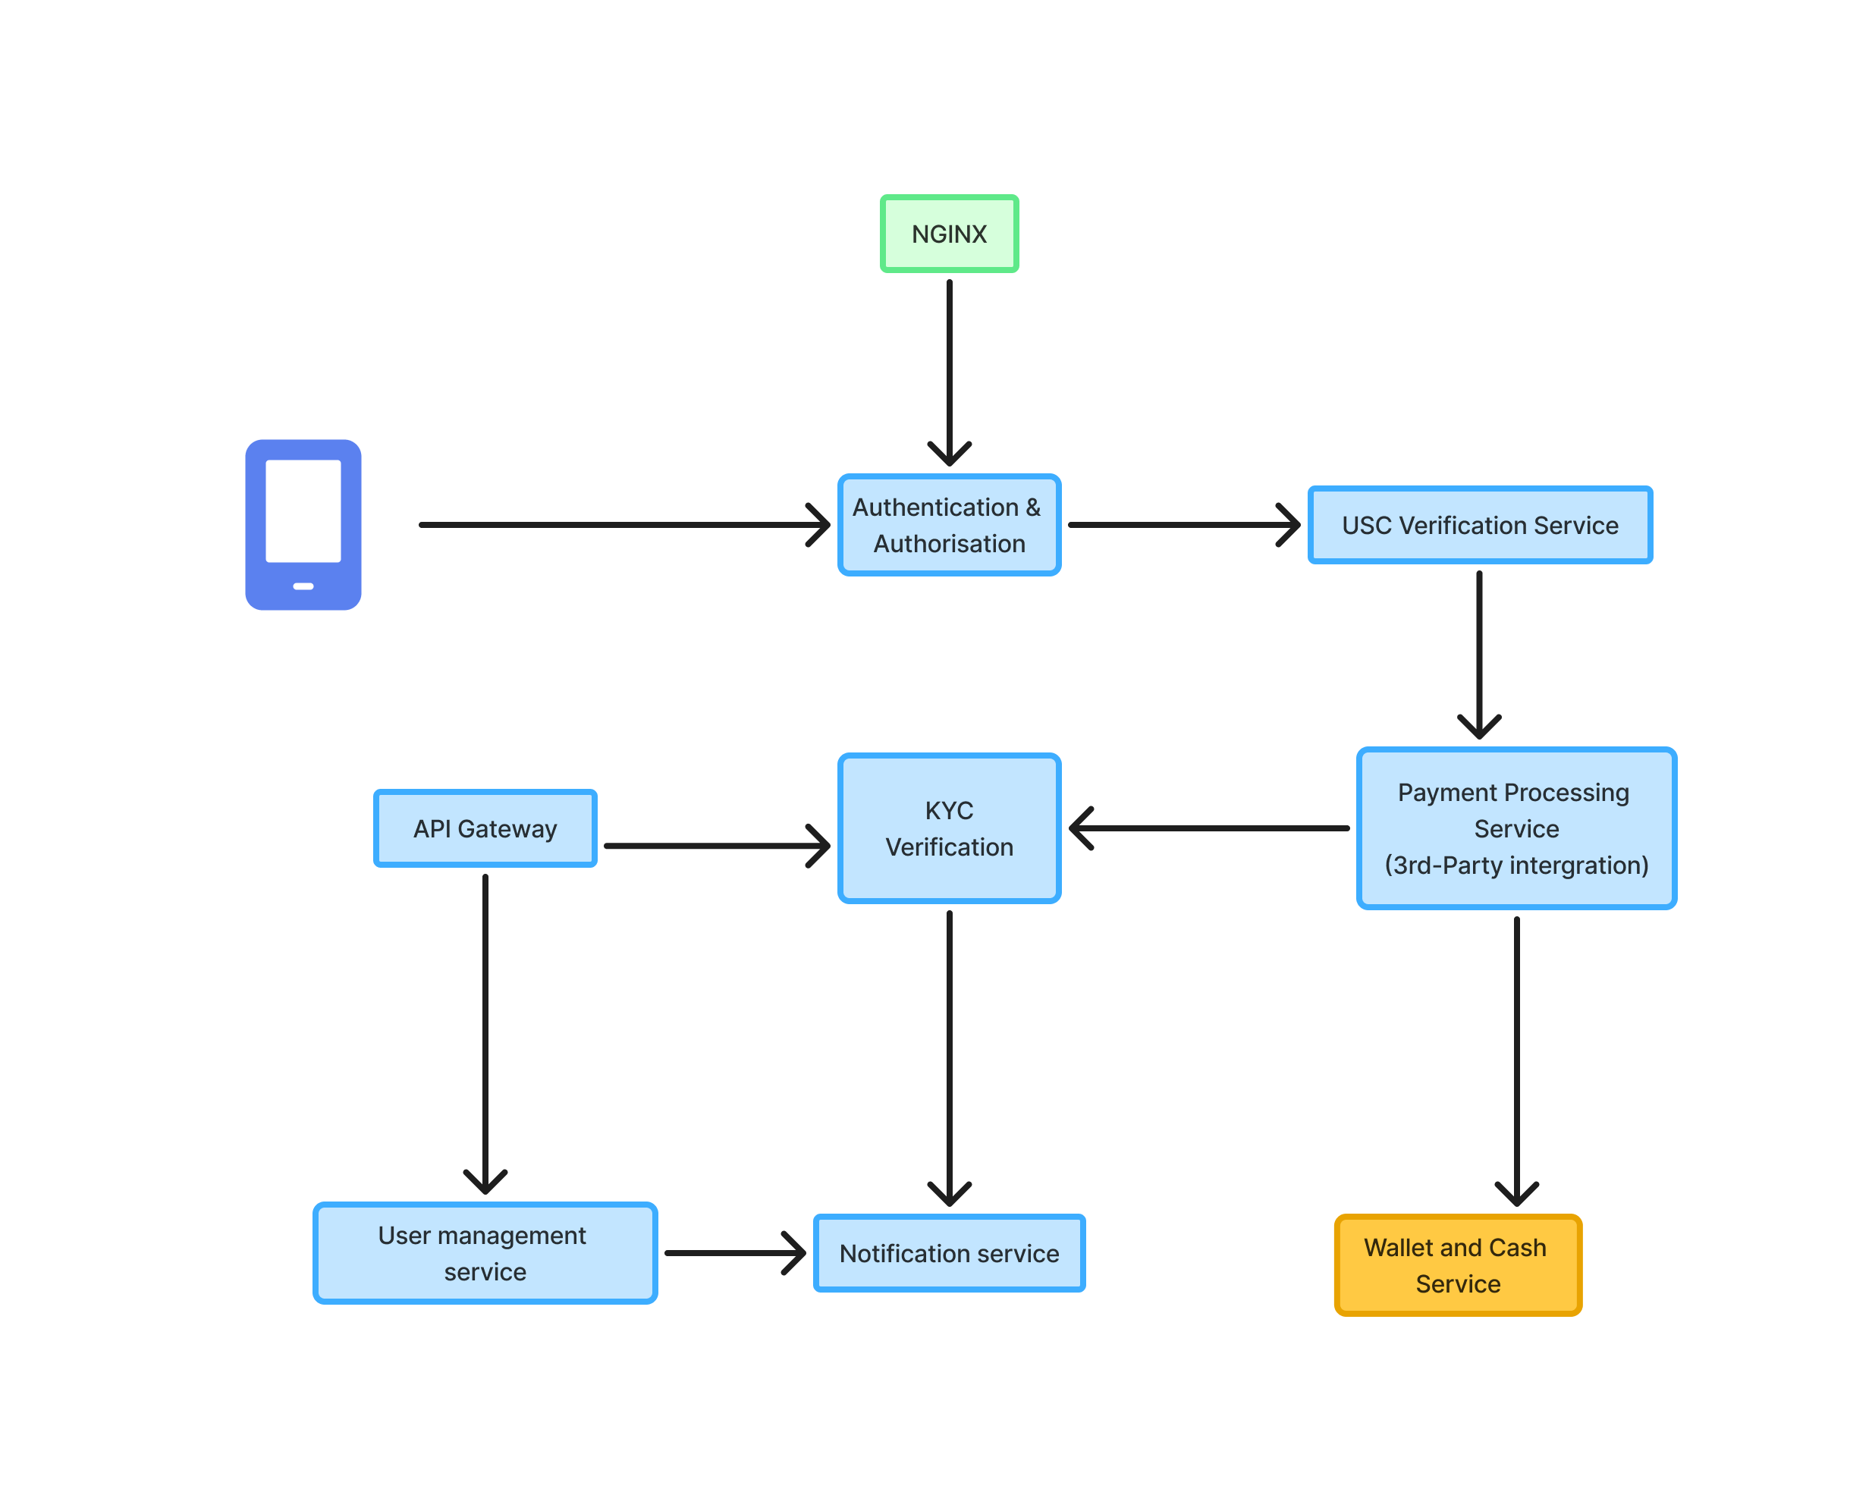
Transaction Flow
1. User Authentication 2. Transaction 3. Fraud Engine evaluates risk 4. Payment processed 5. Wallet updated 6. Notifications

Slide 6
Conclusion
The Virtual Card Financial System delivers a robust, secure, and compliant architecture supporting real-time payments and advanced fraud protection

